Slide 1

The Innovation Lab
Summer Internship 2022
Mentor-Intern Meeting 5
VAAYUBHOOMI
Mentors: Shayak Bhadraray Harshith Kumar MB
T Vijay Prashant
Interns: Pramuk MP
Samuel Thomas
Sriram Radhakrishna

Slide 2
Problem Statement
Networked robots for waste management & associated reconnaissance
Specific use case - Trash collection over open public spaces
UAV patrols a specific path and uses cameras and Lidar to detect trash on the ground
It will store the location of the trash and send it to the UGV that will then use path planning to navigate to the garbage and pick it up
<Project Name>

Slide 3
Proposed Approach
We intend to execute this project in two phases : Phase 1 is a simulation of the UAV and Phase 2 is an implementation of an autonomous system with the UGV.
Phase 1 UAV - Patrol bot that works in a specified area
Detects specific targets (i.e.; piles or individual pieces of waste) while on predetermined patrol path.
Records the pose of the drone at the location of target detection and saves it’s ground coordinate projection.
After saving the locations, they are filtered down to specific points by taking the centroid(s) of the dataset of coordinates found using K-means clustering. Processing of the same occurs at a ground station.
A simulation of the same will be made using the hector quadrotor package.
Phase 2 UGV - Ground vehicle
Cameras and sensors integrated for autonomous capabilities.
The UGV will navigate to the previously mentioned centroid locations, track the targets using a static lidar, clean up each target location using manipulators.
Apply inverse kinematics and modify urdf files of the manipulator of the turtlebot3 to suit the operation.
SLAM, path planning and obstacle avoidance.
<Project Name>

Slide 4
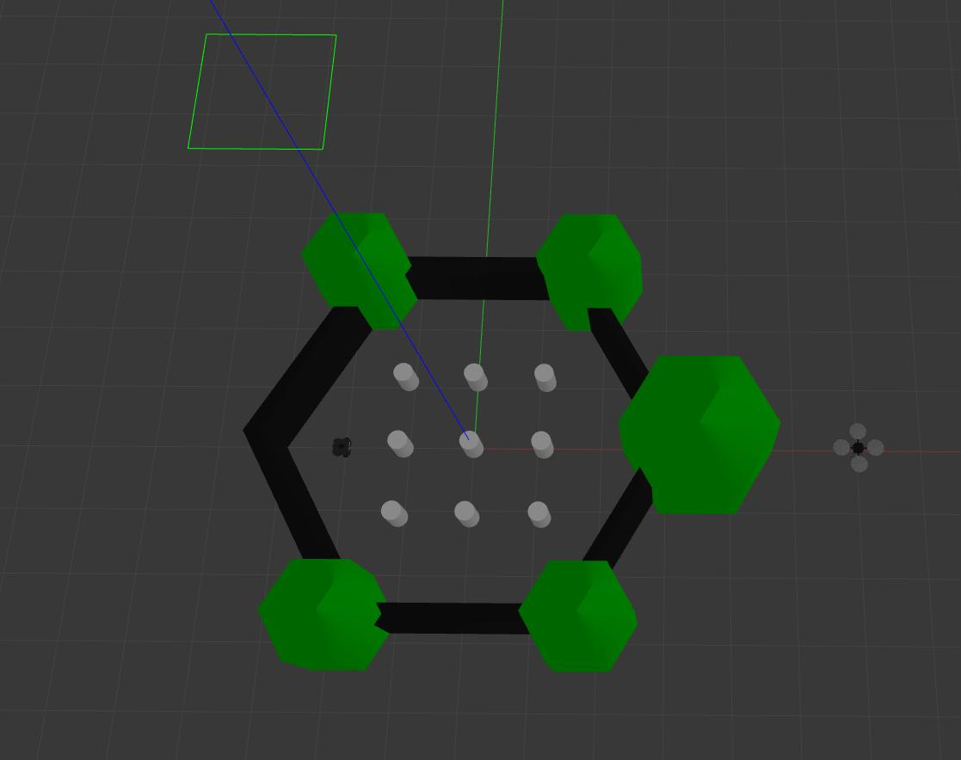
We’ve divided the repository into three branches since the last MIM - trajectory tracking (Pramuk and Samuel) and Vision (Sriram).
Spawned both turtlebot and hector quadrotor in the same environment using launch files.
Trajectory Tracking:
Improved performance of the obstacle avoidance code and fixed bugs. Seems to be working correctly in most of the environments.
Made separate obstacle avoidance module. Other files can import and use it.
Progress 1.0
<Project Name>

Slide 5
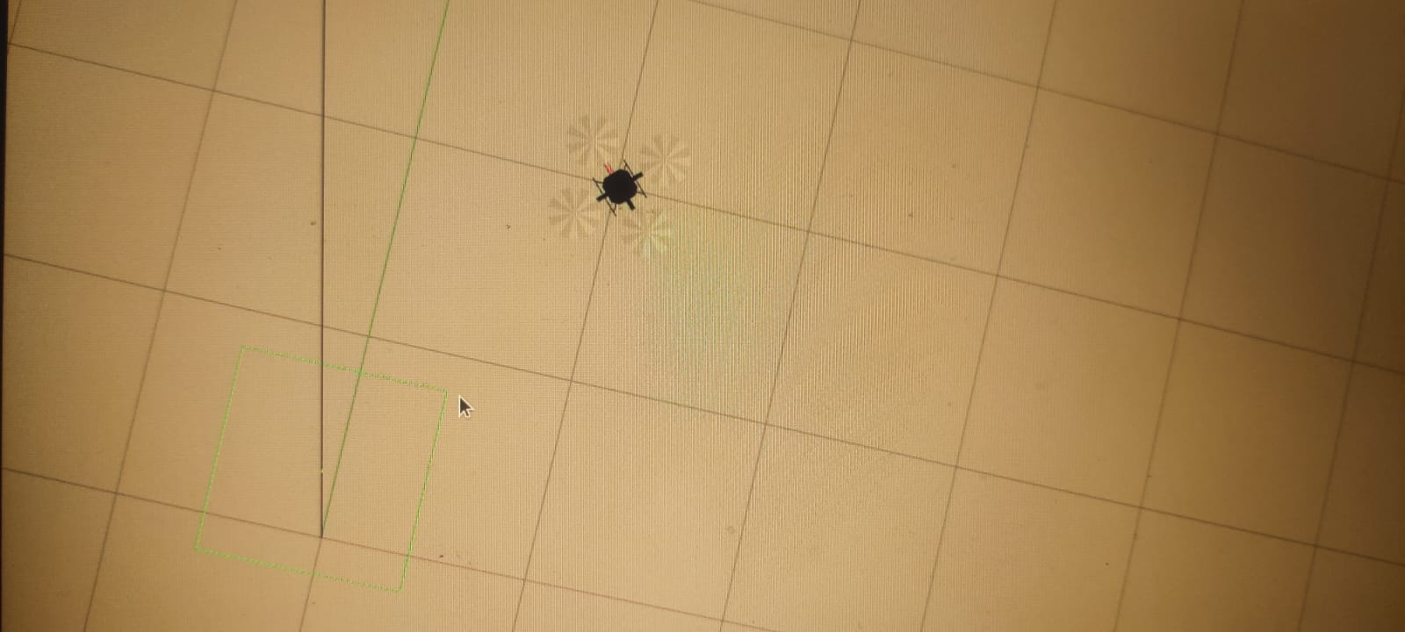
We’ve divided the repository into three branches since the last MIM -
Path planning - Samuel; trajectory tracking - Pramuk; and Vision - Sriram
Focused on Path planning for the hector quadrotor
Path Planning:
Devised a set of four points to form a rectangle in gazebo
Used PID controller, ground_state and angle calculation to make the hector quadrotor move from the origin to each vertex in a predetermined path
Sufficient for end user to enter corners of the area to be surveilled, the UAV will follow the path
Need to implement an inward spiral motion to traverse every point in the area and send trash location to the ground station
Progress 2.0
<Project Name>

Slide 6
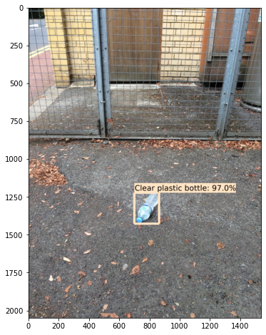
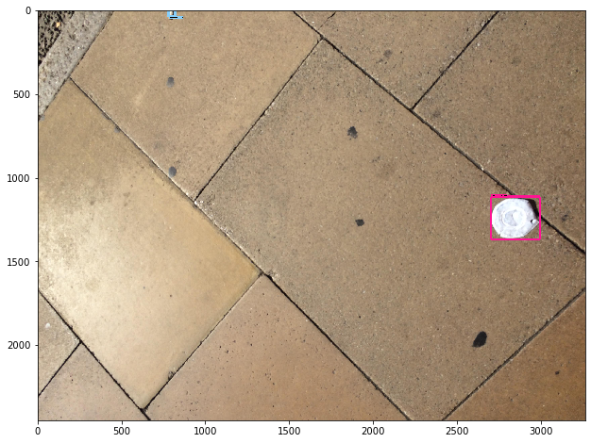
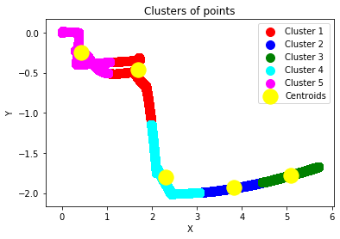
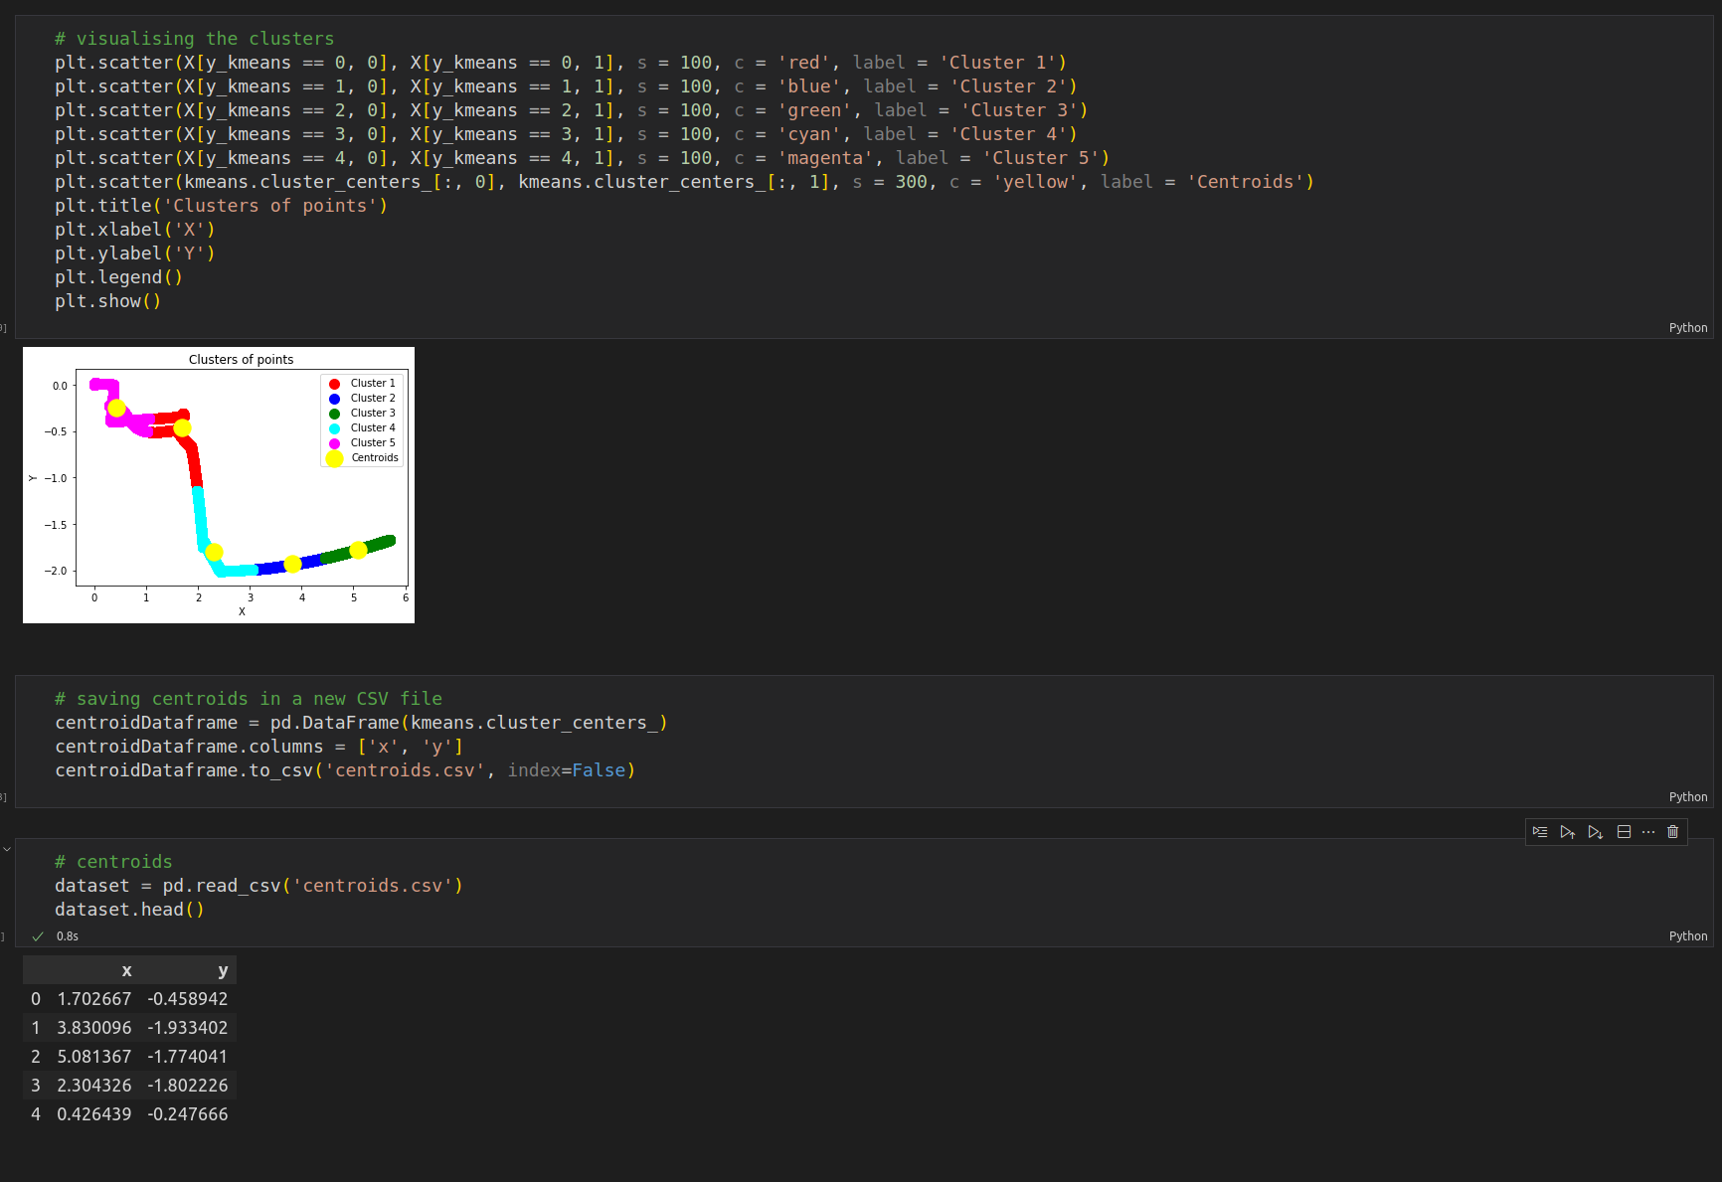
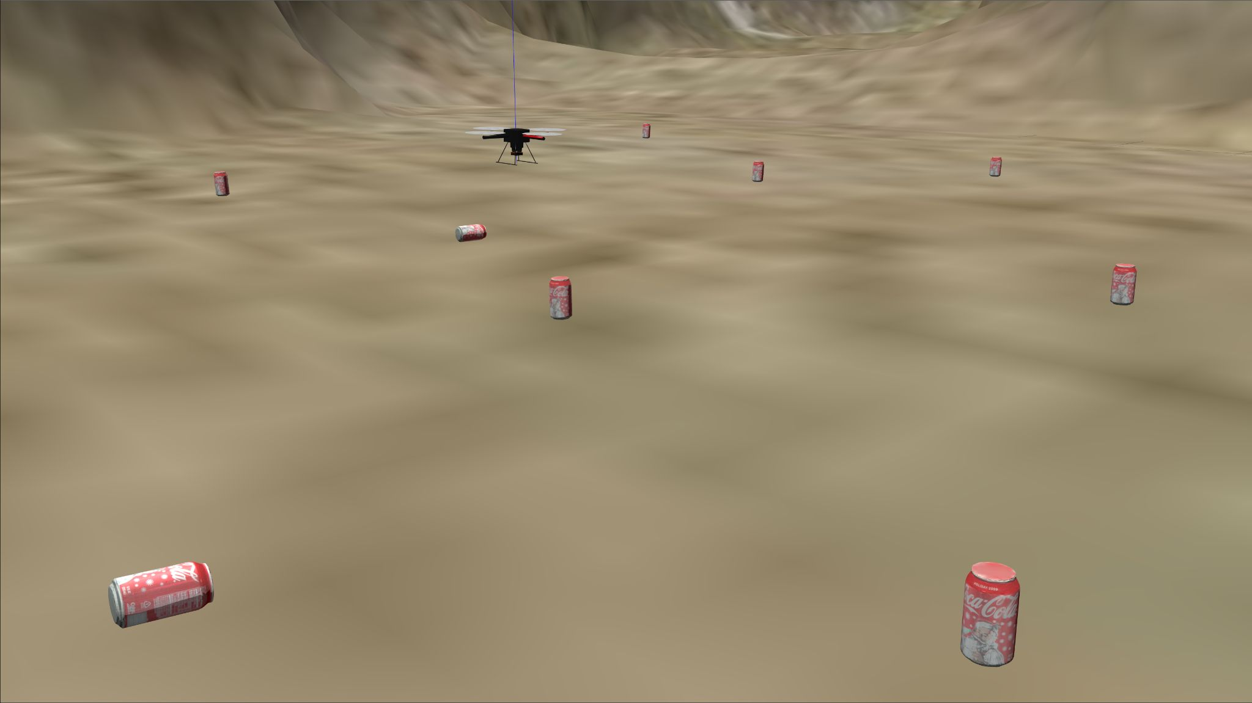
In the vision branch …
Clustering of the collected data points was completed using the K-means method and a pipeline was written to append the points to a CSV file for path planning maneuvers by the UGV.
A transfer learning based model was implemented using Tensorflow to detect 60 different classes of common trash.
This approach was chosen for a better accuracy in use with a simulation due to the availability of individual Gazebo models for each class of trash in the dataset.
This course was taken in contrast to the one presented in the last MIM due to the unnecessary complexity of PyTorch for this use case as well as better latencies in use with a video feed.
Progress 3.0
<Project Name>

Slide 7
Decision to be made between using a ground station or do onboard processing.
Discretization of waypoints along the path of the UAV to mark locations
Location of the UAV when trash detected to be stored in a csv file, that is then incorporated into UGV path planning
Computer Vision to be able to detect trash necessary
Integration of path planning, obstacle avoidance and vision
Use inverse kinematics and end effectors to pick up trash
Garbage to be dropped off at a designated point
Roadmap:
<Project Name>

Slide 8
Plan for the next 2 weeks
Vision:
We’ll be working on implementing the previously mentioned model for trash detection into the UGV in order to identify the ground locations.
Path planning:
UAV spiral path to be created and integrated with obstacle avoidance
UGV path plan to be designed to move to locations given by csv file from vision while avoiding obstacles along the way
<Project Name>

Slide 9
Thank You

